Slide 1
Netzwerk Academy

Slide 2
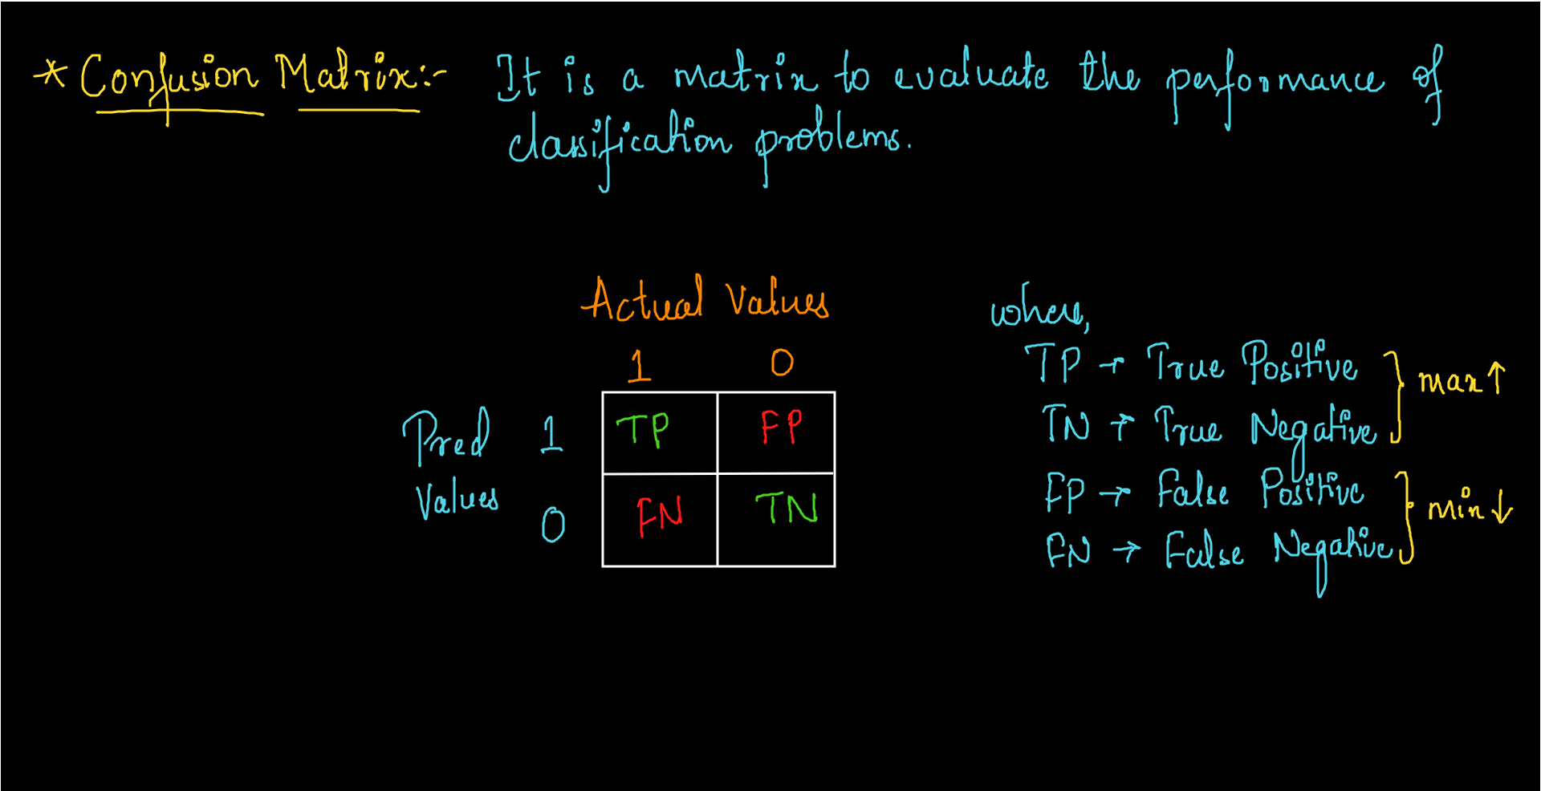

Slide 3
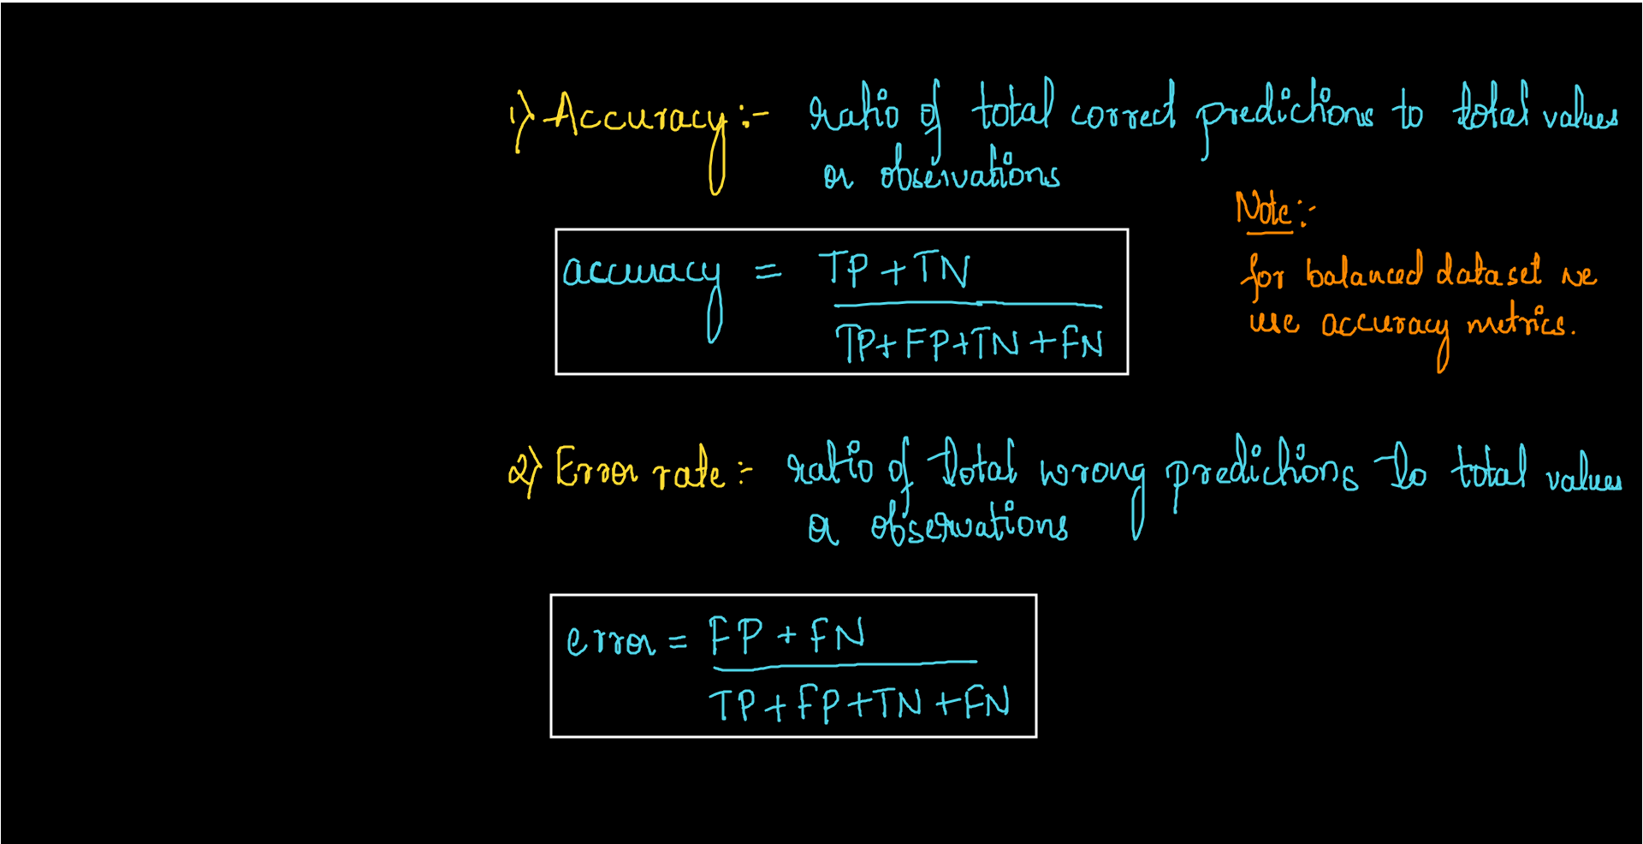
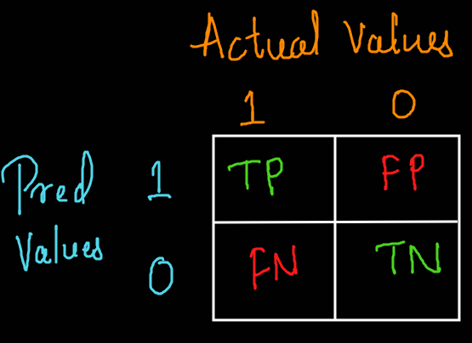

Slide 4
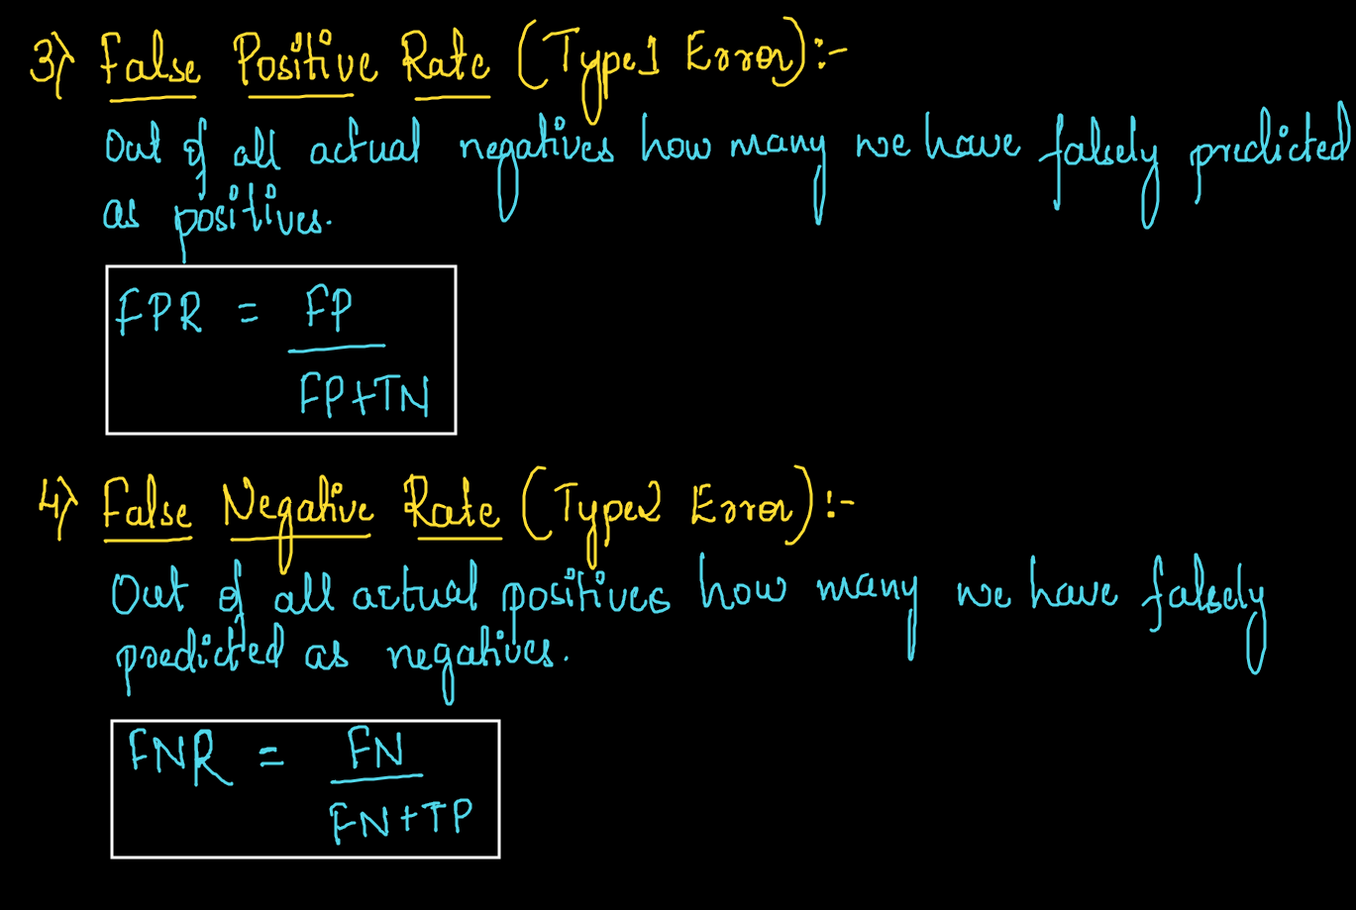

Slide 5
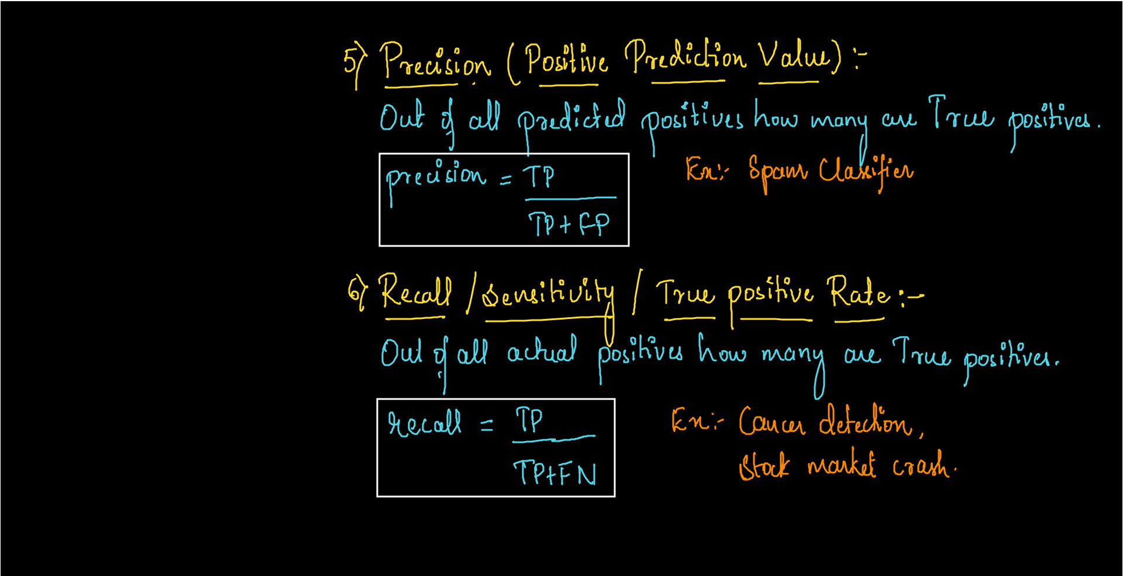

Slide 6
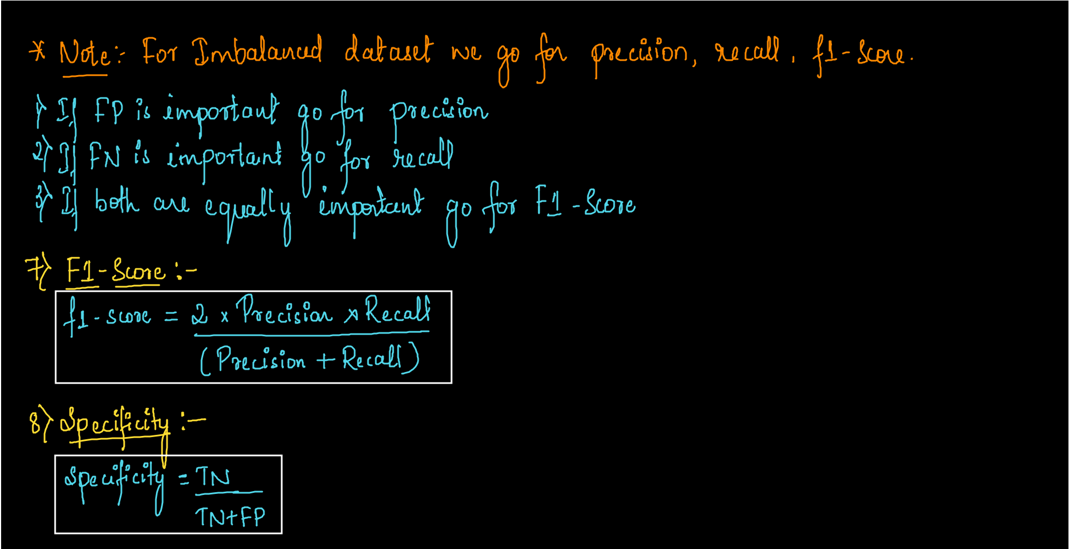

Slide 7
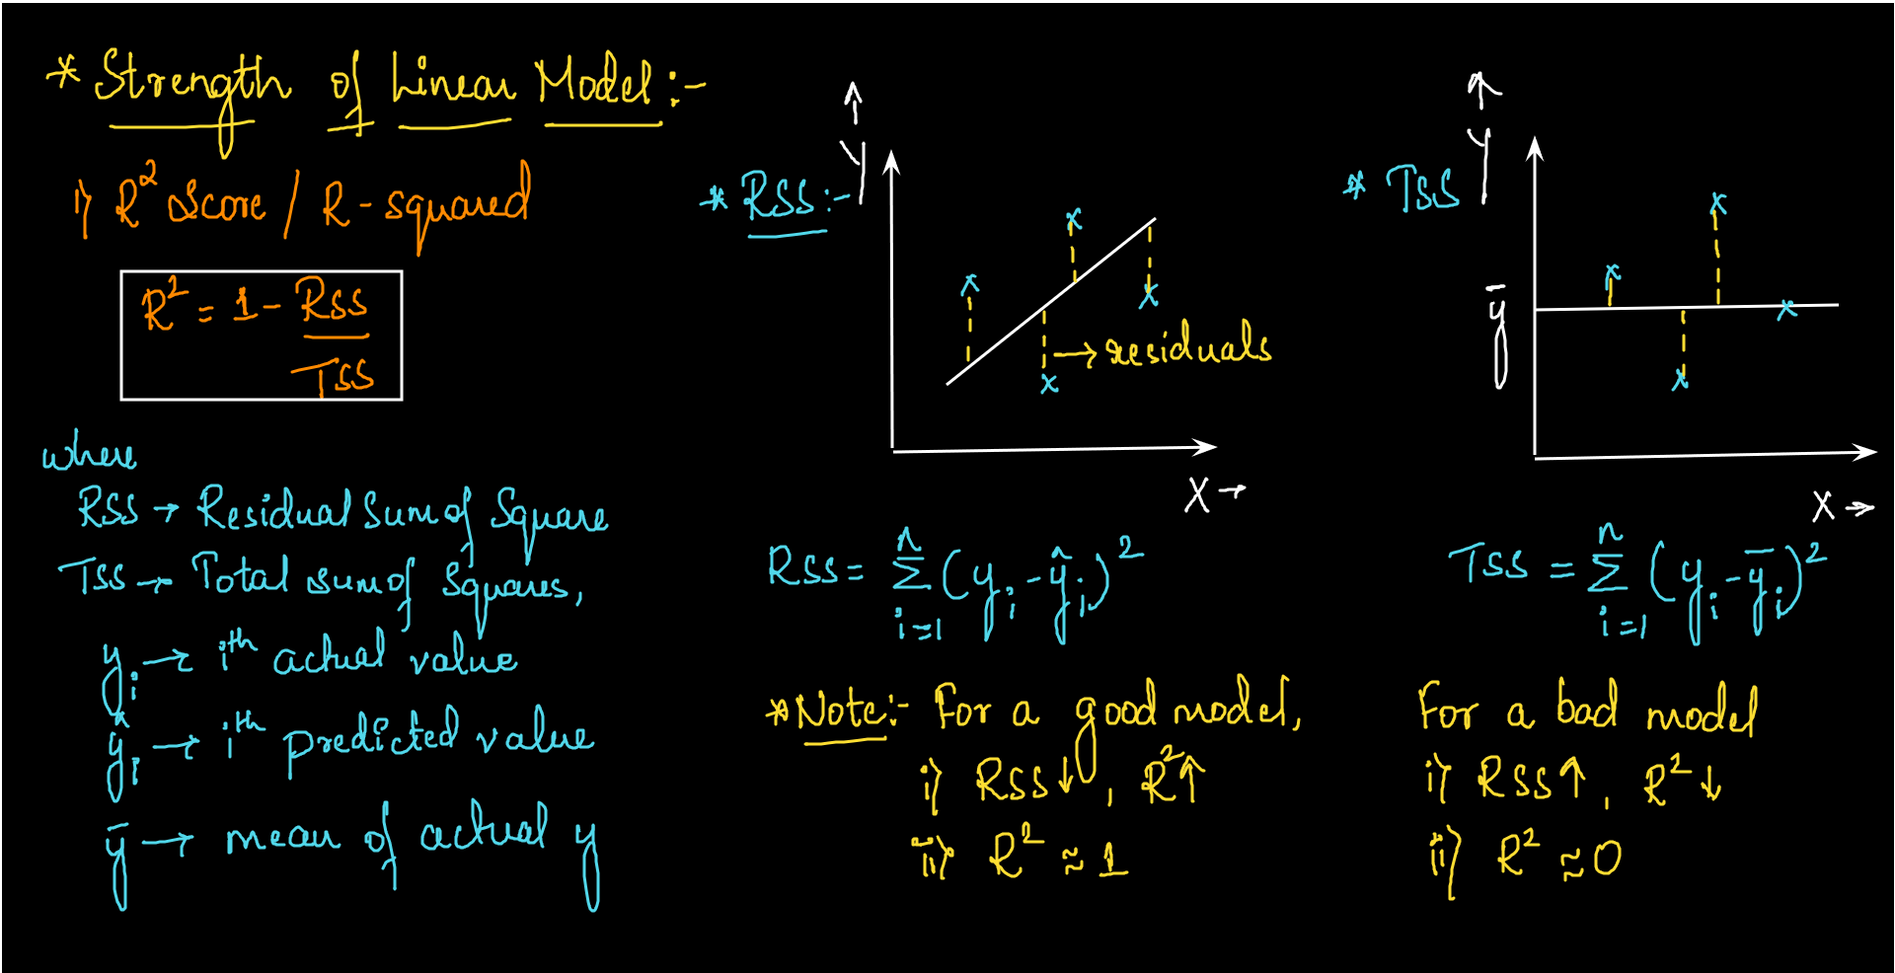

Slide 8
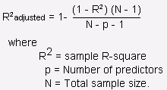
2) Adjusted R-squared
Every time you add a independent variable to a model, the R-squared increases, even if the independent variable is insignificant. It never declines.
Whereas Adjusted R-squared increases only when independent variable is significant and affects dependent

